Slide 1
Network Topologies

Slide 2
Network
A computer network is a group of computers linked to each other by communication links that enables the computer to communicate with each other and share their resources, data, and applications.
Node: Computer, printer, or any device capable of sending and/or receiving data

Slide 3
LAN topologies
Network Topology refers to the physical layout of a network and how different nodes in a network are connected to each other and how they communicate.
Schematic description of a network arrangement, connecting various nodes(sender and receiver) through lines of connection.

Slide 4
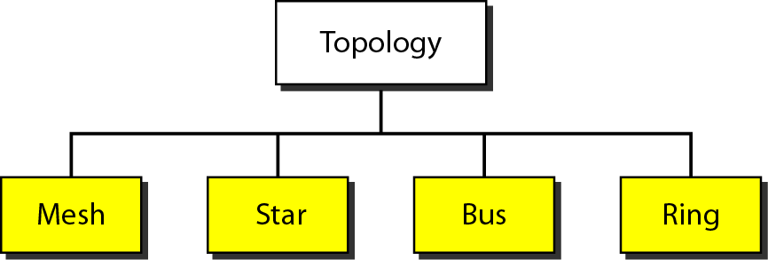
LAN Topologies(Physical)

Slide 5
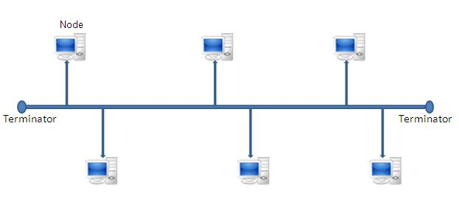
Bus topology
All networked nodes are interconnected, peer to peer, using a single, open-ended cable
Both ends of the bus must be terminated with a terminating resistor to prevent signal bounce

Slide 6
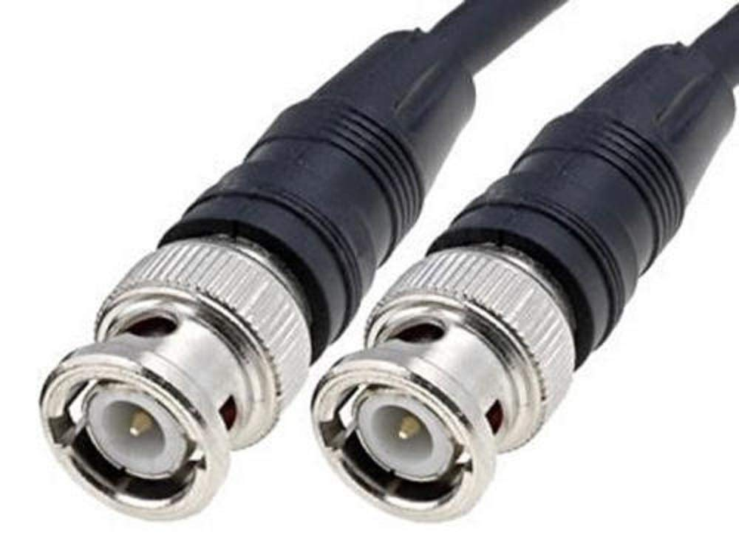
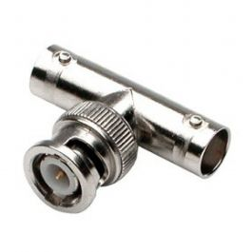
Bus topology
Bus topology sections are connected with BNC(Bayonet Neill–Concelman) connectors.
T connectors are often used to connect the computer to the trunk cable.

Slide 7
Advantages of Bus topology
Easy to implement and extend
Well suited for temporary networks that must be set up in a hurry
Typically the least cheapest topology to implement
Failure of one station does not affect others

Slide 8
Disadvantages of Bus topology
Difficult to administer/troubleshoot
Limited cable length and number of stations
A cable break can disable the entire network; no redundancy
Maintenance costs may be higher in the long run
Performance degrades as additional computers are added

Slide 9
Ring topology
Ring topology is like a bus topology, but with connected ends.
The node that receives the message from the previous computer will retransmit to the next node.
The data flows in one direction, i.e., it is unidirectional (clockwise).
The data flows in a single loop continuously known as an endless loop.

Slide 10
Token Passing
Token passing: It is a network access method in which token is passed from one node to another node.
Token: It is a frame that circulates around the network.
Token contains a piece of information which along with data is sent by the source computer

Slide 11
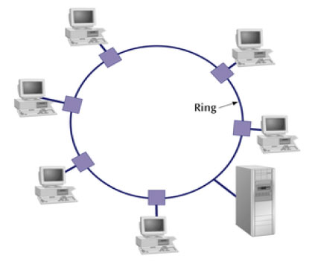
Ring topology

Slide 12
Advantages of Ring topology
This type of network topology is very organized
Performance is better than that of Bus topology
No need for network server to control the connectivity between workstations
Additional components do not affect the performance of network
Each computer has equal access to resources

Slide 13
Disadvantages of Ring topology
Each packet of data must pass through all the computers between source and destination, slower than star topology
If one workstation or port goes down, the entire network gets affected
Network is highly dependent on the wire which connects different components

Slide 14
Star topology
In a star topology all nodes are individually connected to a central connection point, like a hub or a switch.
A star topology is designed with each node (like workstations, printers, laptops, servers etc.) connected directly to a central device (i.e. switch)
Stars have made buses and rings obsolete in LAN topologies

Slide 15
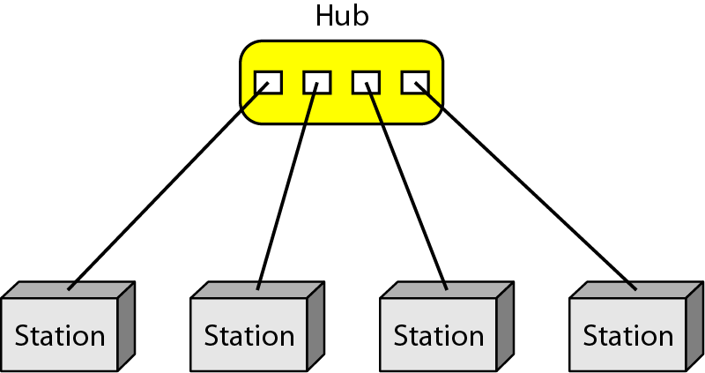
Star Topology
Dedicated point-to-point link only to a central controller, called a hub
Hub acts as an exchange: No direct traffic between devices
Advantages: Less expensive, robust
Disadvantages: dependency of the whole on one single point, the hub

Slide 16
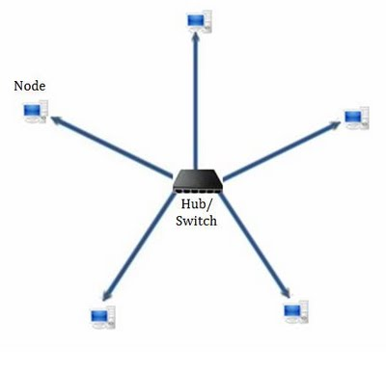
Star topology

Slide 17
Advantages of star topology
Compared to Bus topology it gives far much better performance
Easy to connect new nodes or devices
Centralized management. It helps in monitoring the network
Failure of one node or link doesn’t affect the rest of network

Slide 18
Disadvantages of star topology
If central device fails whole network goes down
The use of hub, a router or a switch as central device increases the overall cost of the network
Performance and as well number of nodes which can be added in such topology is depended on capacity of central device

Slide 19
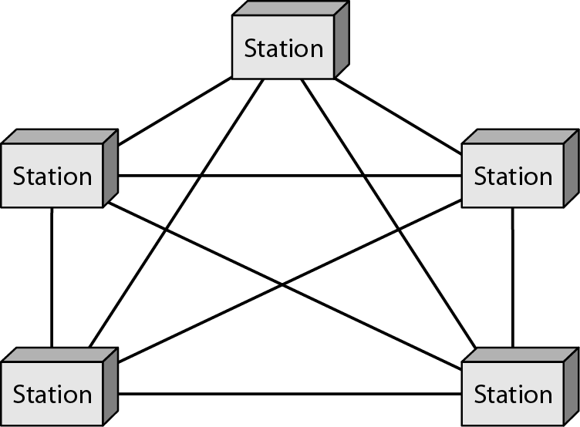
Mesh Topology
Dedicated point-to-point link to
every other nodes
A mesh network with n nodes has n(n-1)/2 links. A node has n-1 I/O ports (links)
Advantages: No traffic problems, robust, security, easy fault identification & isolation
Disadvantages: Difficult installation/reconfiguration, space, cost

Slide 20
Mesh Topology

Slide 21
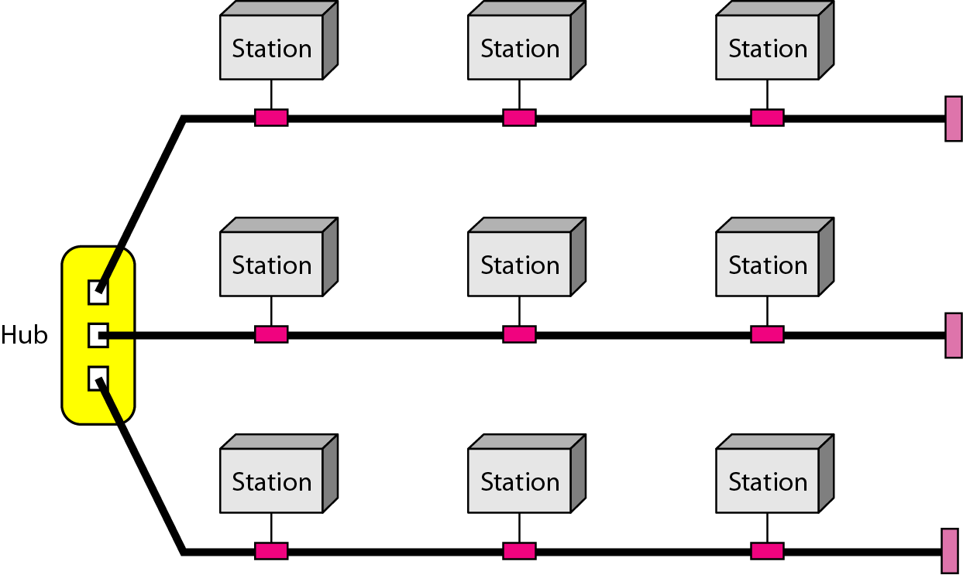
Hybrid Topology
Example: Main star topology with each branch connecting several stations in a bus topology
To share the advantages from various topologies

Slide 22
Thank You!

